Slide 1



DRB-2002
Quality Education and Study Genie

Slide 2
Problem Statement
Many students struggle with studying and often need extra support to achieve academic success.
However, finding effective and accessible resources can be challenging, especially for those with limited time or financial resources.
Notes:
There isnt a single document that has answers to all questions,
even if there are, the way its explained cant possibly be clear for everyone
The Student Genie app aims to address this problem by providing a user-friendly platform that offers a variety of study tools and resources to help students maximize their learning potential.

Slide 3
Main Functionality
Interact with documents using Natural Language processing
Notes:
The Student Genie app aims to address this problem by providing a user-friendly platform that offers a variety of study tools and resources to help students maximize their learning potential.

Slide 4

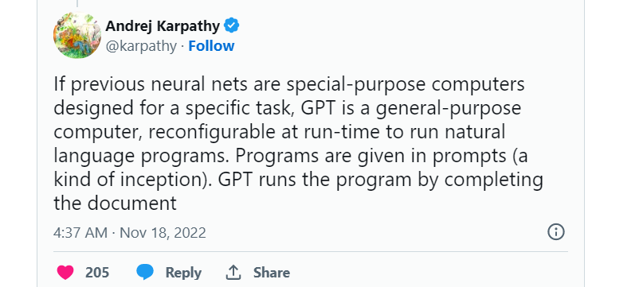
Notes:
In this day and age we have come so far in terms of AI
This is a tweet by Andrj who was the Head of AI at Tesla
What hes basicaly stating is how much we have advanced in our capabilities
The current models that we have are so powerful, their domains are wide and large
We believe that the business that are going to win need to harness these advanced technologies

Slide 5
The Solution use
The Student Genie app aims to assist students in studying by summarizing notes, generating questions and generating flashcard.
The features offered by the Student Genie app use the student's own lecture notes as input to generate concise and organized summaries and quizzes
Notes:
This ensures that the summaries and quizzes are tailored to the specific lecture content and reflect the student's own understanding of the material, while also saving time and effort by condensing large amounts of information into easily digestible chunks.

Slide 6

1 .Provides Accessible Study Resources
Notes:
The app offers a user-friendly platform with a variety of study tools and resources, making it easy for students to access and use them.

Slide 7

2. Saves Time and Effort
Notes:
The summarizing feature of the app saves students time and effort by condensing large amounts of lecture material into concise summaries. This helps students better understand and retain the material, and enables them to study more efficiently.

Slide 8
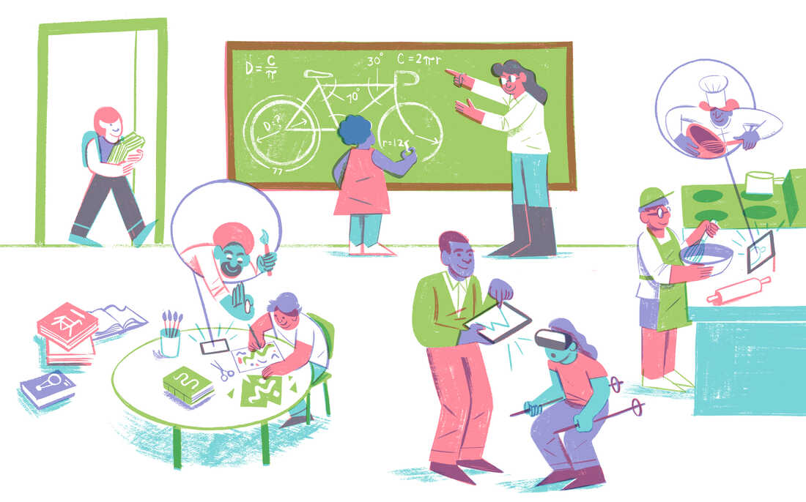
3. Personalized Learning
Notes:
The app generates summaries and quizzes based on the student's own lecture notes, which ensures that the material is tailored to their specific course content and the content is personalized material.

Slide 9
Targeted Users
Demographics
Location: Developing nations
Age range: 12 +
Education status: Secondary education up to Tertiary education
Notes:
Anyone whos doing research

Slide 10
Technologies used
Programming languages, tools and version control
Flutter, Javascript, React, Python
Github
Langchain and OpenAI
Notes:
Langchain - Large language models

Slide 11
Team members and Responsibilities
Beteab
Front End
Dagim
Back End
Etsub
Designer & Presenter
Yeabsira
Front End

Slide 12
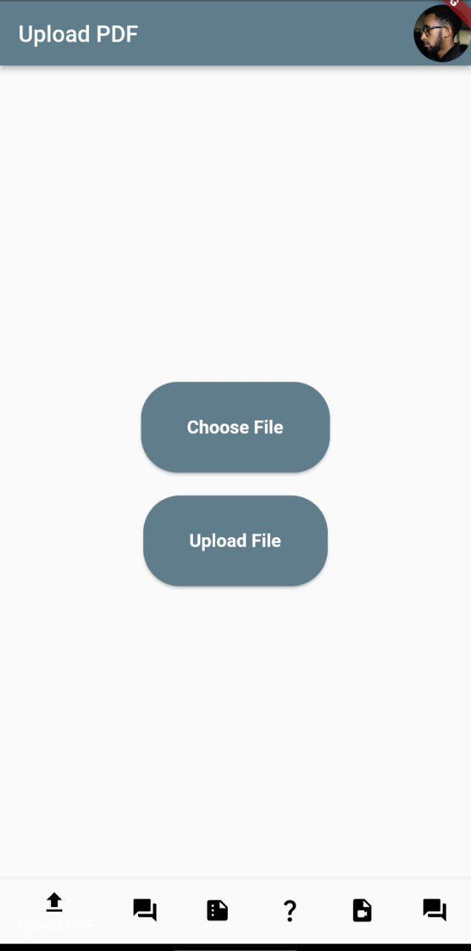
Place your screenshot here
Android project

Slide 13
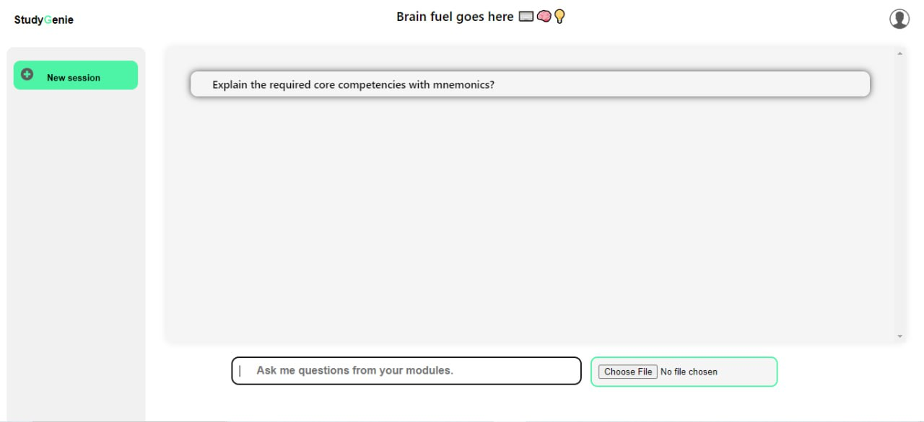
Place your screenshot here
Desktop project

Slide 14
Thanks!
Any questions?

